Slide 1

Staff Virtual Recognition and Appreciation Day
Friday, May 21st 2021
11:00AM

Slide 2


Recognition of Staff
for
Years of Service, Special Recognition,
Degrees and Certifications
This Photo by Unknown author is licensed under CC BY-NC-ND.

Slide 3




Celebrating Years of Service
This Photo by Unknown author is licensed under CC BY-NC-ND.

Slide 4

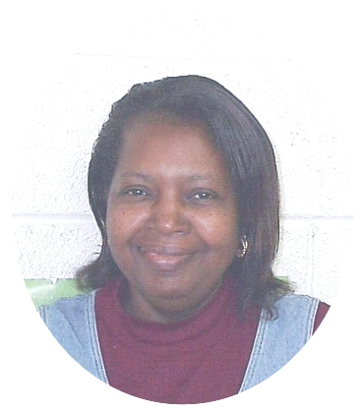
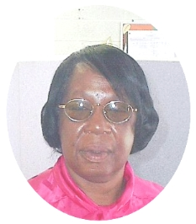
Gloria Faison Earlie Flythe
October 1995-Present October 1995-Present
HS/EHS Child Development Floater Cafeteria Manager
Hertford Co. Child Development Center Woodland EHS/HS
This Photo by Unknown author is licensed under CC BY-NC-ND.

Slide 5

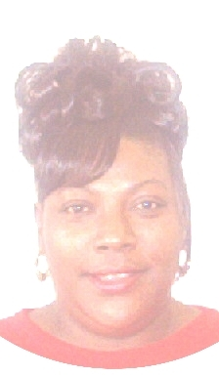
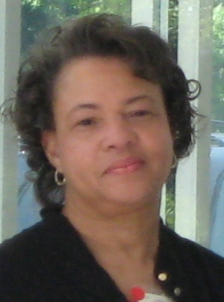
Ronna Johnson Carolyn Robinson
October 1995-Present October 1995-Present
Teacher Assistant/Bus Monitor Staff Development Coordinator
Woodland EHS/HS All HS/EHS Centers
This Photo by Unknown author is licensed under CC BY-NC-ND.

Slide 6
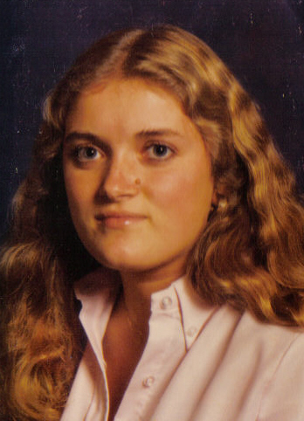
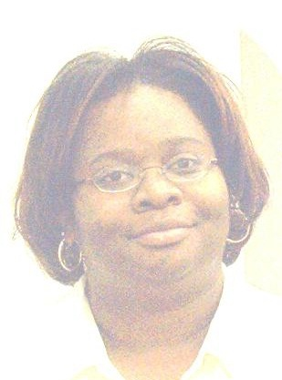
Sheryl Cooke Yumeka Demery
September 2005-Present September 2005-Present
Teacher Assistant/Bus Monitor Behavior/ Family Services Specialist
Hertford Co. Child Development Center Windsor Head Start
This Photo by Unknown author is licensed under CC BY-NC-ND.

Slide 7
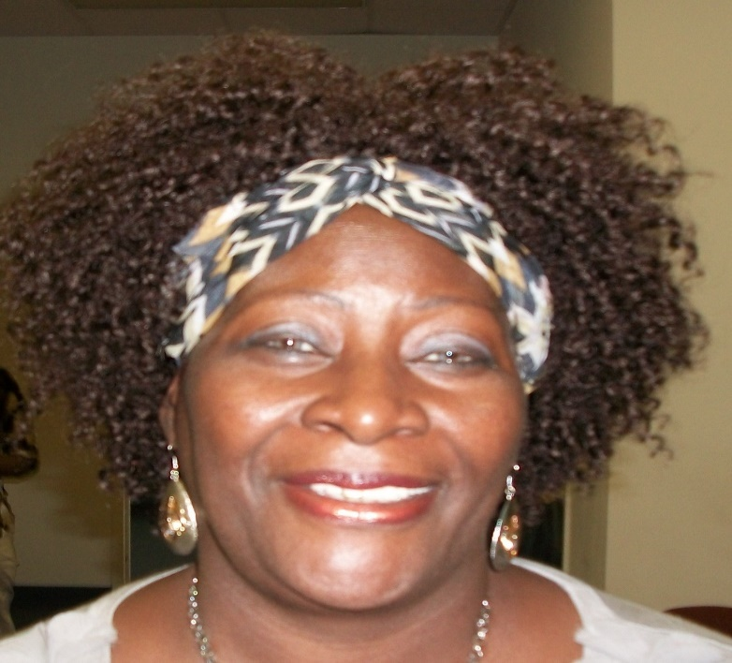
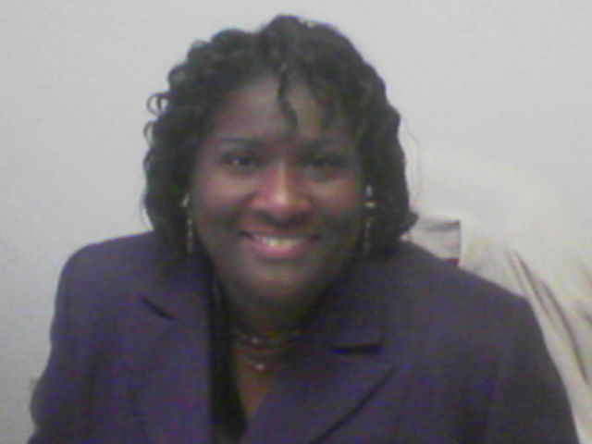
Christine Stephenson Pamela Taylor
September 2005-Present April 2005-Present
Early Head Start Coordinator Parents As First Teacher Coordinator
All EHS Centers Hertford and Northampton Counties
This Photo by Unknown author is licensed under CC BY-NC-ND.

Slide 8
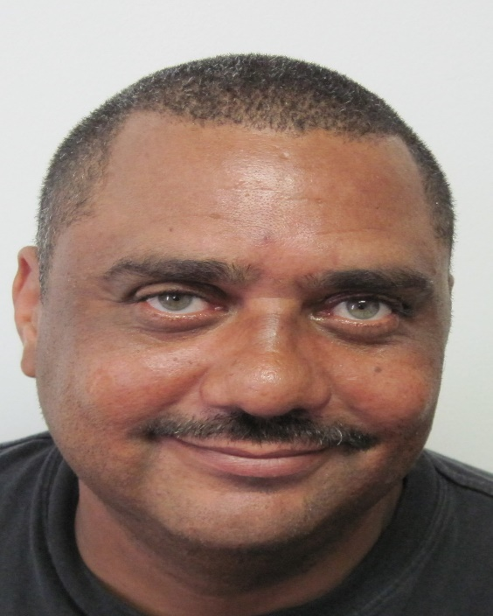
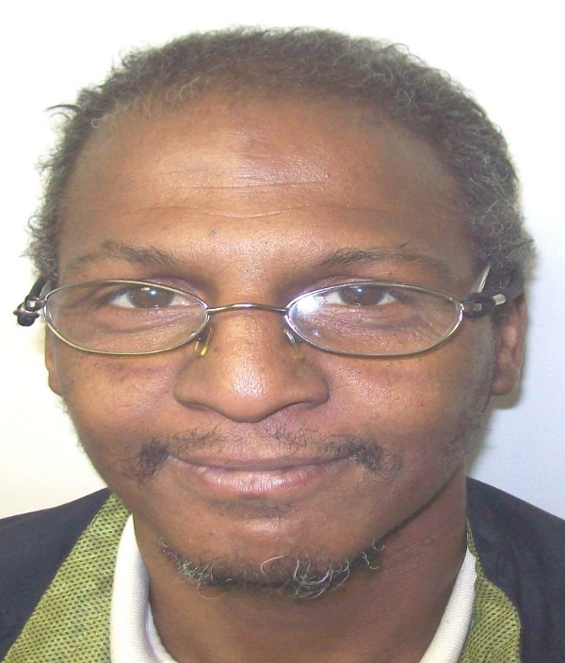
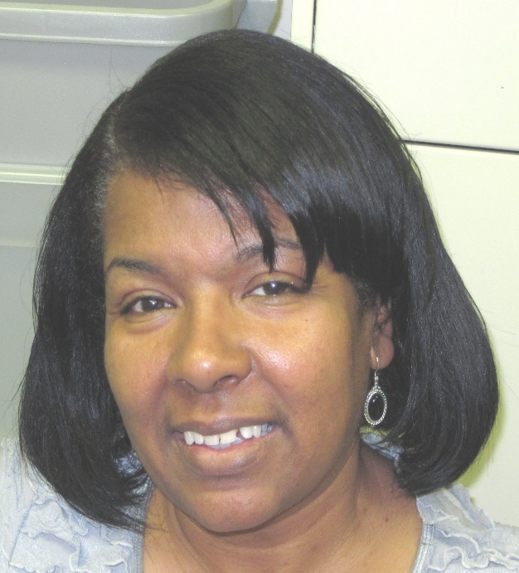
Jimmy Alston Marvin Evans Barbara Fleming
June 2010-Present March 2010-Present October 2010-Present
Maintenance Supervisor Custodian CSBG Case Manager-Halifax
All EHS/HS Centers White Oak EHS/HS Halifax Co. CADA Office
This Photo by Unknown author is licensed under CC BY-NC-ND.

Slide 9

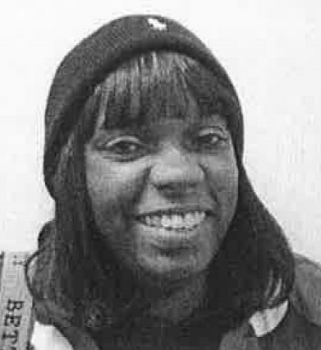
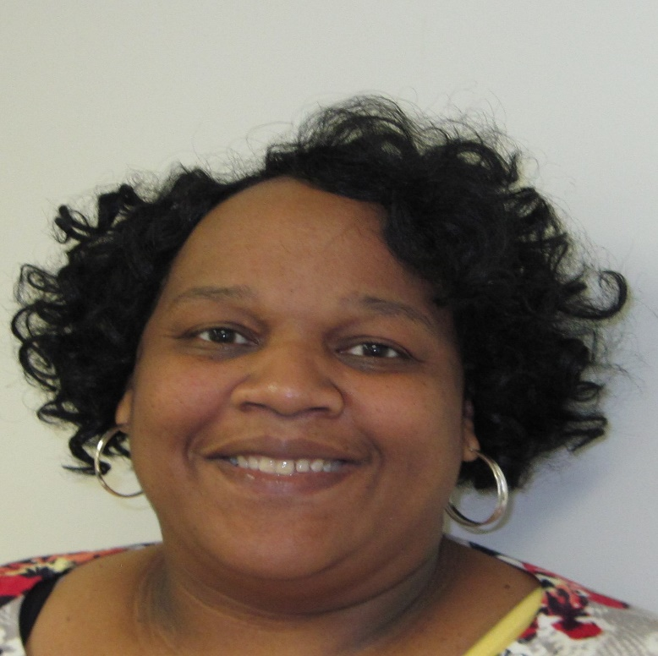
Candrace Armstrong Connie Bazemore
October 2015-Present September 2015-Present
Cafeteria Manager Parent Involvement Coordinator
White Oak EHS/HS All HS/EHS Families
This Photo by Unknown author is licensed under CC BY-NC-ND.

Slide 10
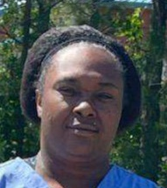
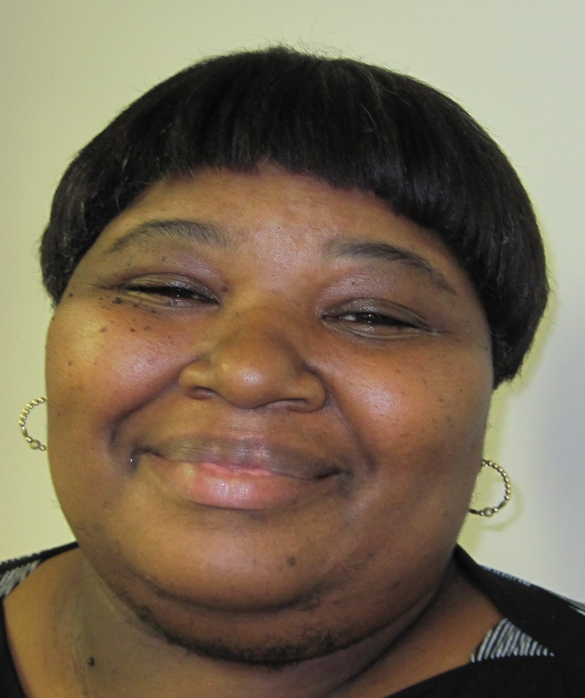
Levita Bishop Regina Lewis
October 2015-Present September 2015-Present
Cafeteria Assistant Family Service Specialist
Hertford Co. Child Development Center Scotland Neck EHS/HS
This Photo by Unknown author is licensed under CC BY-NC-ND.

Slide 11
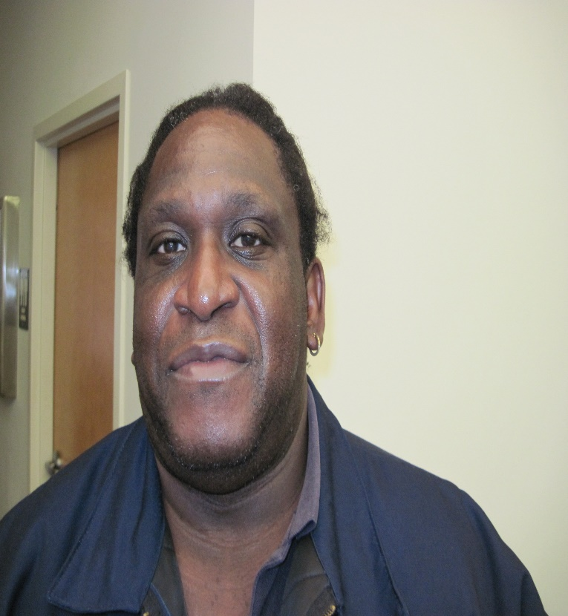
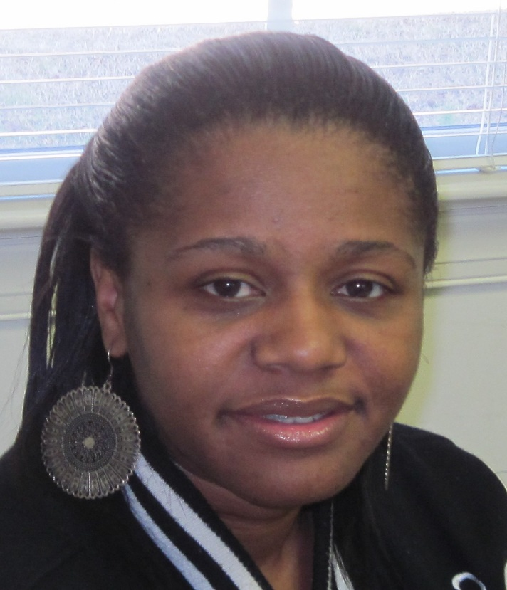
Amos Price Renarda Richardson
October 2015-Present January 2015-Present
Custodian Family Service Specialist
Halifax Community College HS/ Clara Hearne Early Childhood Center
Roanoke Life Center
This Photo by Unknown author is licensed under CC BY-NC-ND.

Slide 12


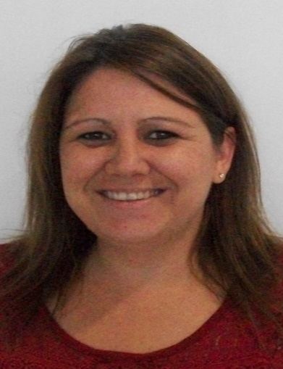
Special Recognitions
Leyetta Batchelor- Child Development Teacher at Halifax Community College HS
Wrote and Published her 4th children’s book
under her Indie publishing business Endless Possibilities Publishing
Stephanie Floyd- a partner Head Start Teacher at Clara Hearne
Honored by RRGSD as The Best New Teacher in the
district for the 2020-2021 school year
This Photo by Unknown author is licensed under CC BY-NC-ND.

Slide 13


Degrees and Certifications
This Photo by Unknown author is licensed under CC BY-NC-ND.

Slide 14
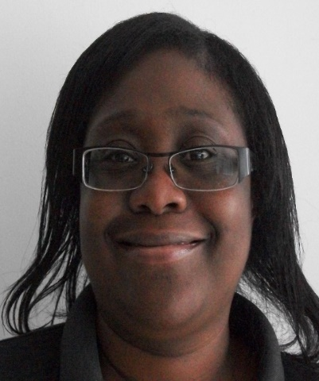
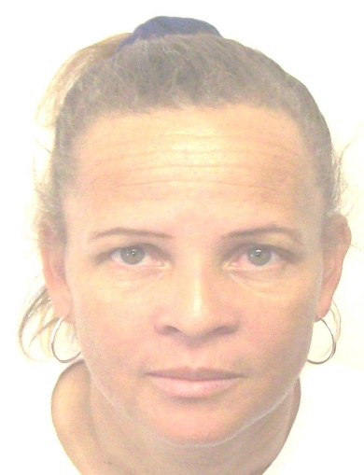
Degrees
Christina Powell- Teacher Assistant at Halifax Community College Head Start, Bachelor’s Degree in Social Science, Chowan University, May 2021
Beverly Boone- NC Pre-K Teacher at Woodland Head Start, Bachelor’s Degree in Early Childhood Education (Birth-Kindergarten), University of Mount Olive, May 2021
This Photo by Unknown author is licensed under CC BY-NC-ND.

Slide 15
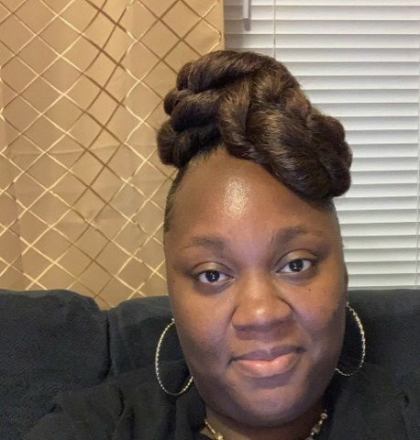

Degrees
Michelle Freeman- Teacher Assistant at Hertford County Child Development Center, Associate Degree in Early Childhood Education, Roanoke-Chowan Community College, May 2021
Stephanie Floyd- Head Start Teacher at Clara Hearne Head Start (Partner) and Roanoke Rapids Graded School, Bachelor’s Degree in Education, Summer of 2020
This Photo by Unknown author is licensed under CC BY-NC-ND.

Slide 16
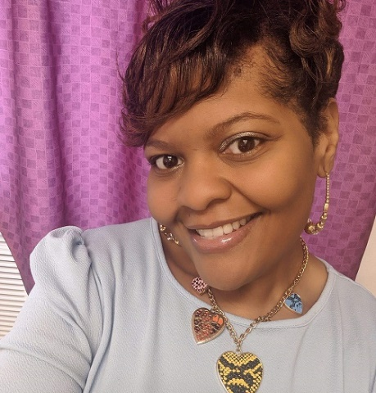
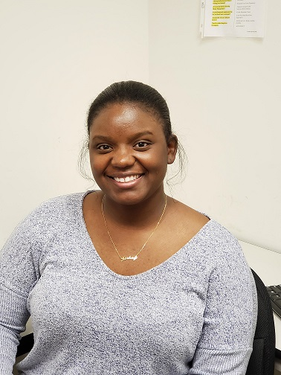
Degrees
Tameika Taylor- CADA CARES Case Manager Halifax/Northampton Counties, Master’s Degree in Social Work, Western New Mexico University, May 2021
Keshay Williams- Child Development Teacher at Roanoke Life Center, Associate Degree in Early Childhood and a second Associate Degree in the Arts, Halifax Community College, May 2021
This Photo by Unknown author is licensed under CC BY-NC-ND.

Slide 17
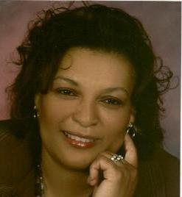
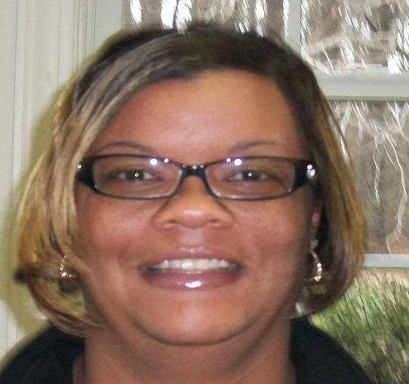
Certifications
Doris Richardson-Child Development Center Manager at White Oak Head Start/ Early Head Start, completed the Triple P-Positive Parenting Program
Latarsha Riddick-Child Development Center Manager at Hertford County Child Development Center, completed the Triple P-Positive Parenting Program
This Photo by Unknown author is licensed under CC BY-NC-ND.

Slide 18

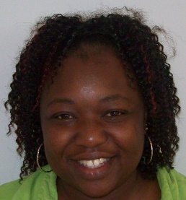
Certifications
Tamera Jefferies-Family Service Specialist at Halifax Community College Head Start, completed the Child Development Associate program
Chrisey Crews- Child Development Teacher at Hertford Co. Child Development Center, received her residency license, January 2021
This Photo by Unknown author is licensed under CC BY-NC-ND.

Slide 19

Certifications
Tameika Taylor- CADA CARES Case Manager at Northampton/Halifax Offices, completed certification in Rural Community Social Work Services
This Photo by Unknown author is licensed under CC BY-NC-ND.

Slide 20
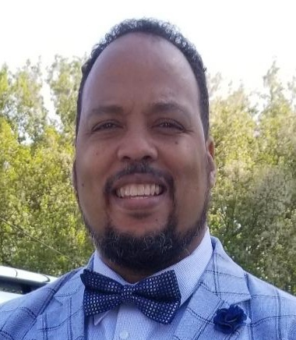
Certifications
Andre’ Rowe- CADA’S Finance Director Completed the Executive Leadership for Financial Professionals Certification, Southern University A & M College-Continuing Education Division, November 2020
This Photo by Unknown author is licensed under CC BY-NC-ND.

Slide 21

Retirements
This Photo by Unknown author is licensed under CC BY-NC-ND.

Slide 22

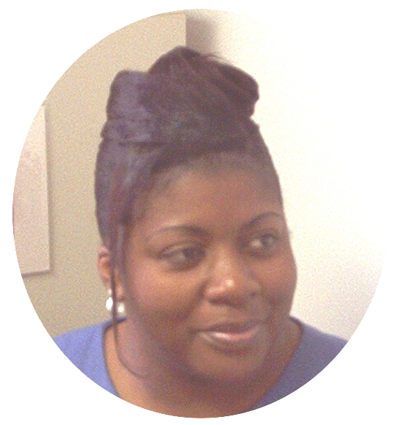
Retirement
Patricia Myrick
March 9, 1992 - November 30, 2020
Family Service Specialist
Windsor Head Start
This Photo by Unknown author is licensed under CC BY-NC-ND.

Slide 23
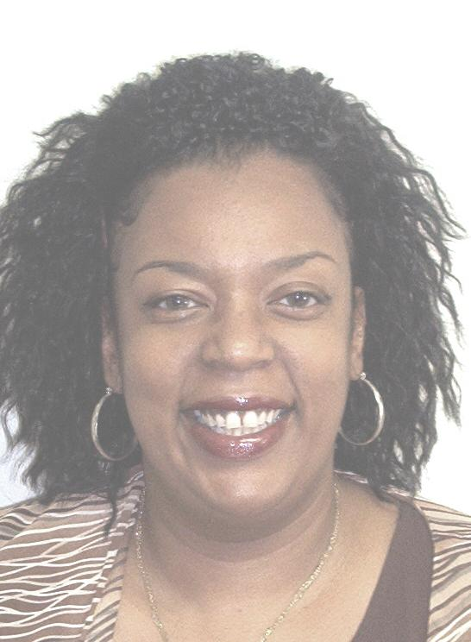
Retirement
Regina Harrell
October 2, 1995 - March 31, 2021
Family and Community Engagement Manager
All HS/EHS Centers, Children, and Parents
This Photo by Unknown author is licensed under CC BY-NC-ND.

Slide 24
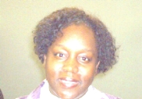
Retirement
Deborah Tucker
September 1, 1999 - May 31, 2021
Family Service Specialist II
Weldon Head Start
This Photo by Unknown author is licensed under CC BY-NC-ND.

Slide 25
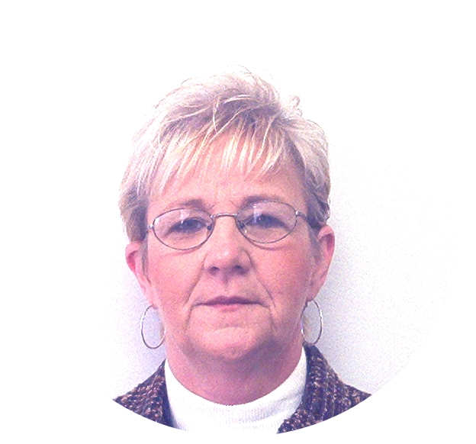
Retirement
Gail Walker
November 13, 1989- June 30, 2021
Community Service Center Manager
Halifax Co. CADA Office
This Photo by Unknown author is licensed under CC BY-NC-ND.

Slide 26


This Photo by Unknown author is licensed under CC BY-NC-ND.

