Slide 1

Recognition of Staff for
Years of Service,
Special Recognition,
Degrees and Certifications

Slide 2
Years of Service

Slide 3
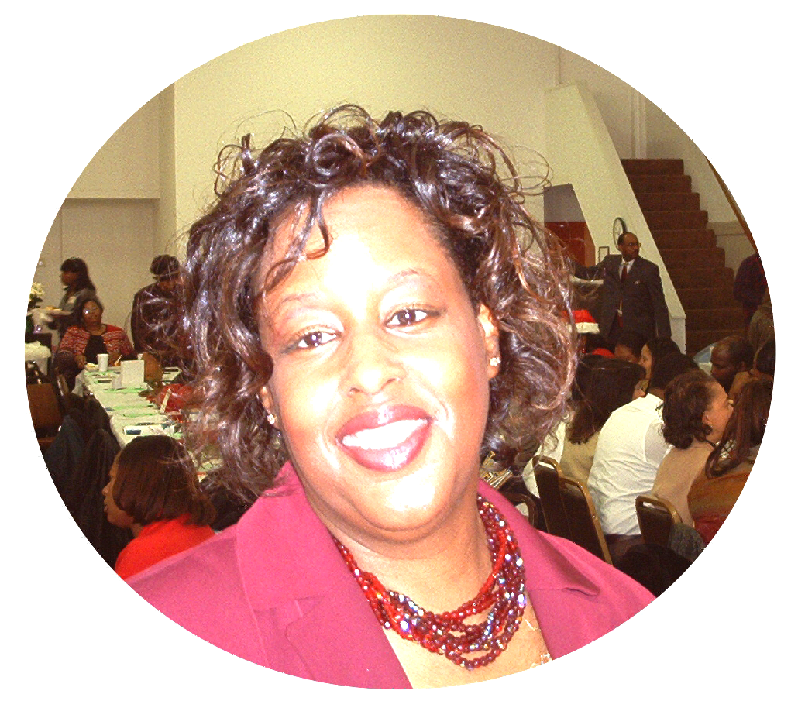
35 Years
Wendy Futrell
Housing Choice Voucher Program Manager
June 1984-Present

Slide 4
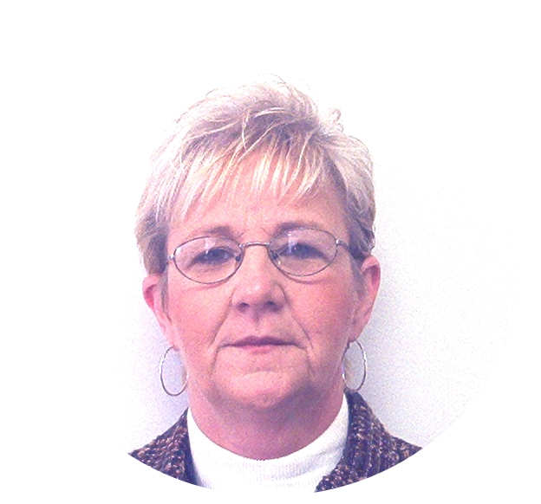
30 Years
Elizabeth Walker
Community Service Center Manager (Halifax County)
November 1989-Present

Slide 5
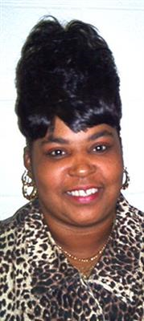
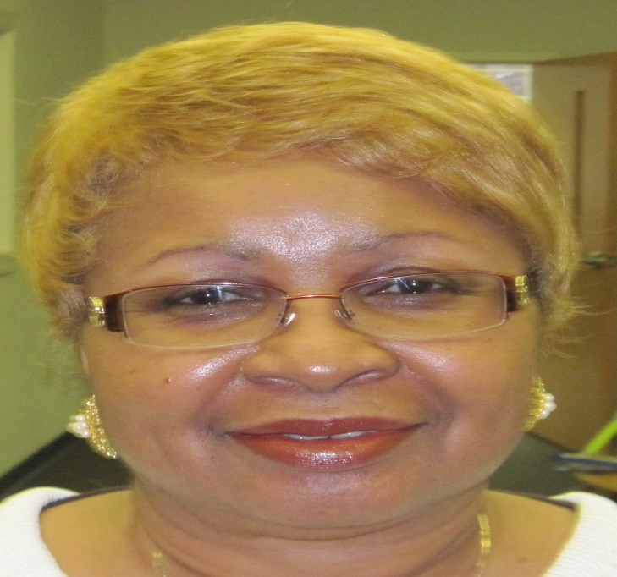
20 Years
Sheri Cox
Child Development Teacher
October 1999-Present
Brenda Greene
Manager of Homebuyers Assistance Program
April 1999-Present

Slide 6
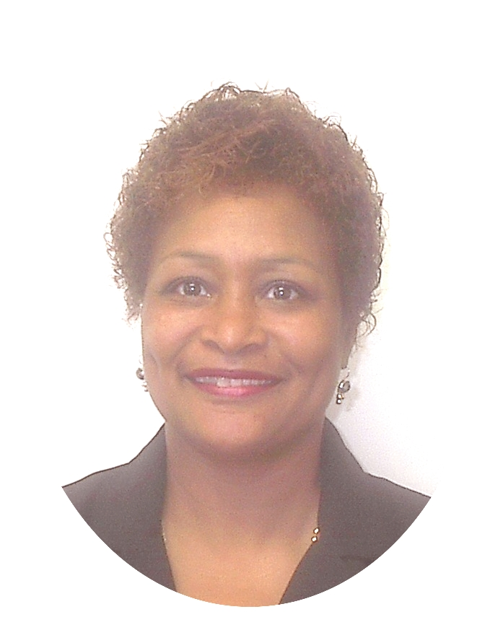
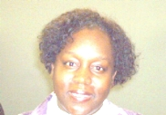
20 Years
Jacqueline Melton
Community Service Center Manager (Hertford County)
September 1999-Present
Deborah Tucker
Head Start Family Service Specialist II
September 1999-Present

Slide 7

20 Years
Marion Williams
Housing Data Specialist
February 1999-Present

Slide 8
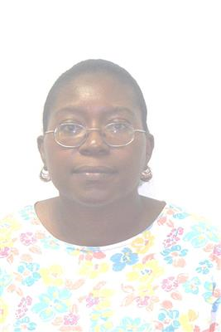
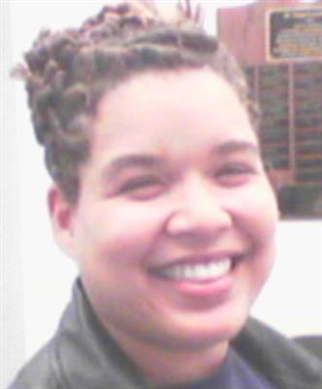
15 Years
Martha Clark
Infant Toddler Teacher
April 2004-Present
Ayesha Harry
Family Service Site Manager
October 2004-Present

Slide 9
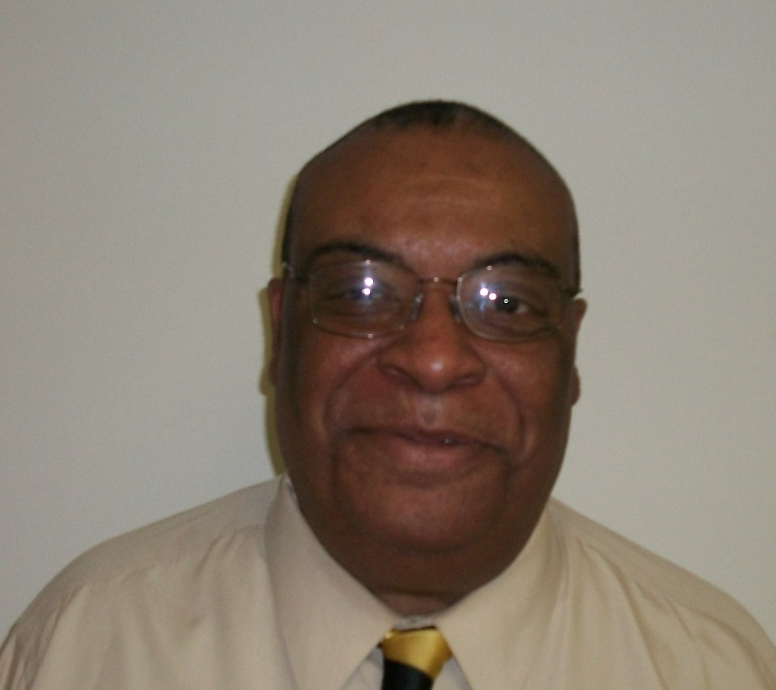
12 Years
Melvin Powers
Deputy Director
September 1992-August 1999
January 2014-December 2019

Slide 10
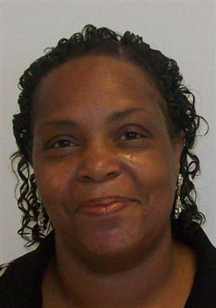
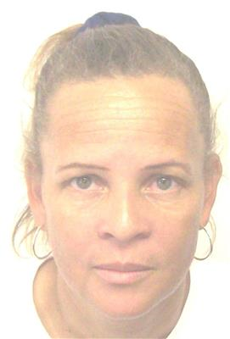
10 Years
Beverly Boone
NC Pre-K Child Development Teacher
August 2009-Present
Elsie Barber
Child Development Teacher
March 2009-October 2020

Slide 11
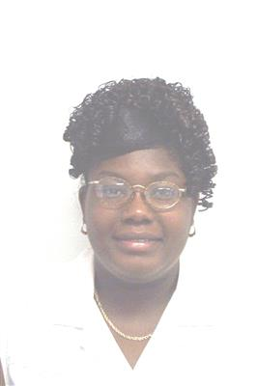
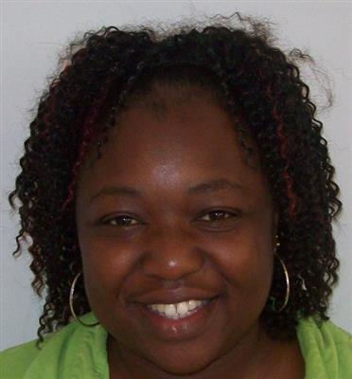
10 Years
Jane Bridgett
Home Based Specialist
August 2009-November 2020
Chrisey Crews
Child Development Teacher
March 2009-Present

Slide 12
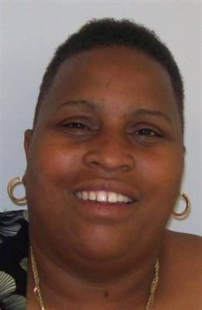
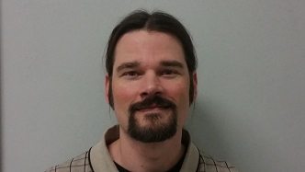
10 Years
Vickie Garcia
Teacher Assistant/Bus Monitor
August 2009-Present
Brent Hignite
Case Manager/Energy Educator
September 2009-Present

Slide 13
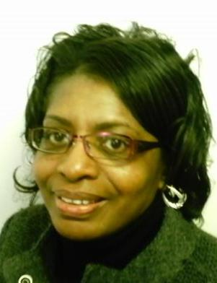
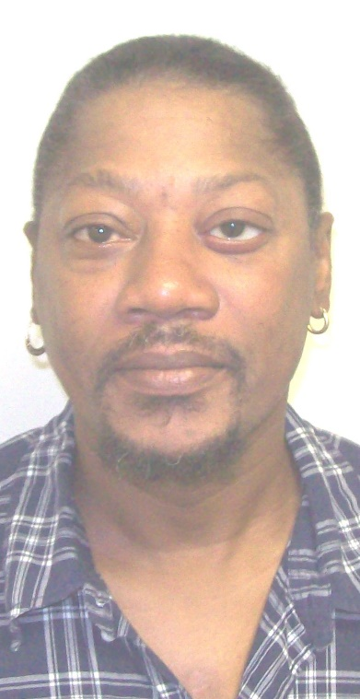
10 Years
Velma Leathers
Teacher Assistant/Bus Monitor
March 2009-Present
Garfield Williams
Weatherization Technician II
September 2009-June2020

Slide 14
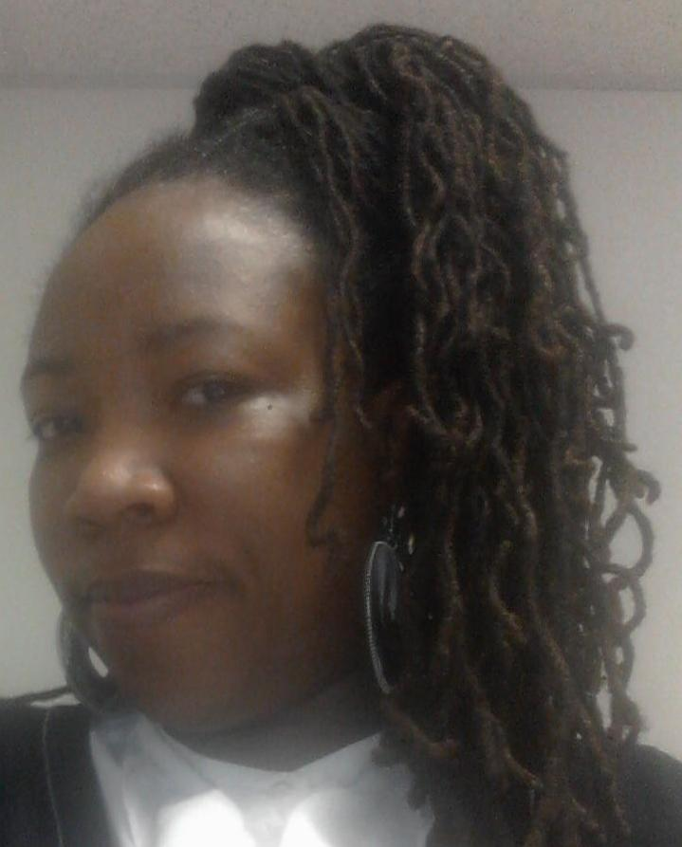
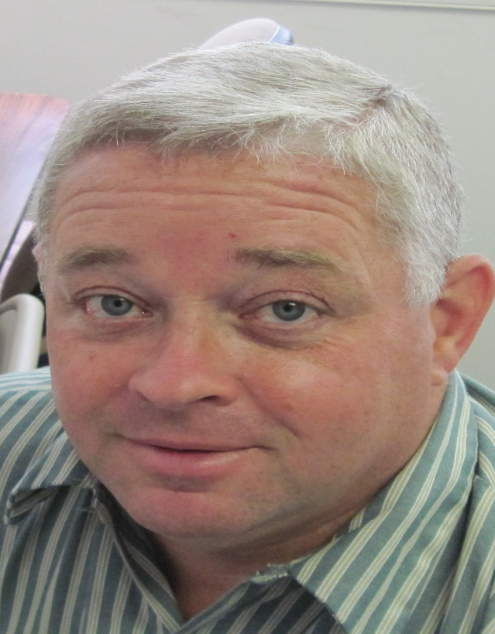
10 Years
Allisa Wilson
Assistant ERSEA Coordinator
January 2009-Present
Roy Worrells
Weatherization Coordinator
October 2009-Present

Slide 15
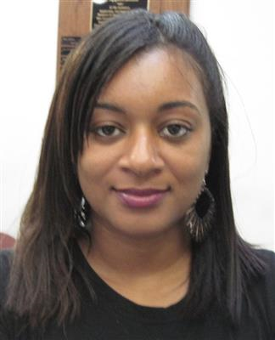
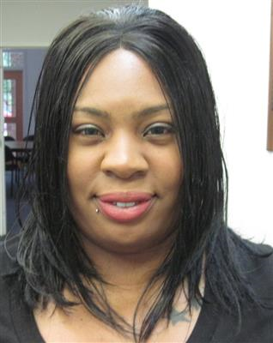
5 Years
Tiffany Davis
Family Service Specialist
November 2014-August 2020
Hannah Futrell
Infant Toddler Teacher
September 2014-Present

Slide 16
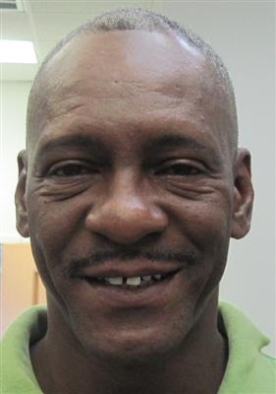
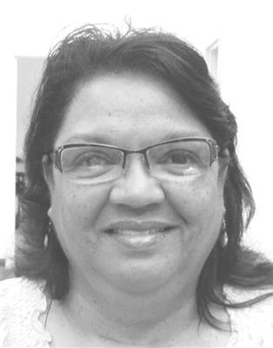
5 Years
Tony Gatling
Custodian II
September 2014-Present
Charlotte Richardson
Child Development Floater
September 2014-Present

Slide 17
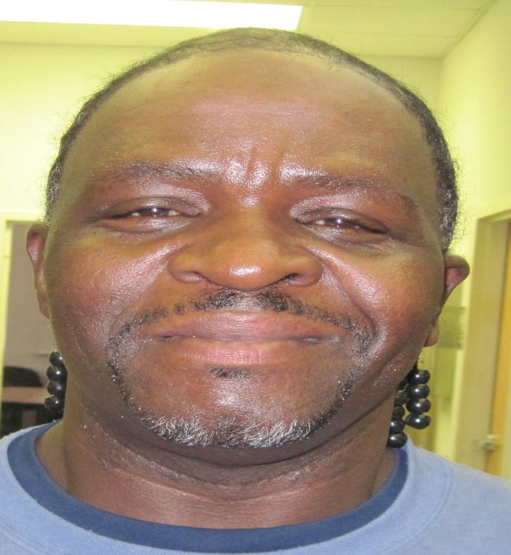
5 Years
Ronald Williams
Weatherization Technician II
November 2014-Present

Slide 18

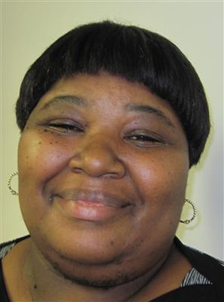
Special Recognition
North Carolina Head Start Association Patricia Beier Family Advocate of the Year Award
Regina Lewis
HS/EHS Family Service Specialist

Slide 19

Degrees and certifications

Slide 20
Degrees
Miranda Lassiter- Masters Degree Human Services in Community Services
Chrisey Crews- Bachelor Degree in Early Childhood Education
Sheltonya Vaughan- Residency License Birth-Kindergarten
Lakirah Quimby- Child Development Associate (CDA)

Slide 21
Certifications

Slide 22
CSBG-Community Services Staff
The following have completed a Case Management Certification through North Carolina Community Action Association in partnership with Southern University:
Aleta Tootle
Sherrie Bazemore
Tameika Taylor
Emily Jordan
Barbara Fleming
Roy Moore

Slide 23
Head start/early head start
Head Start Family Engagement Credential from NCCAA & Southern University
Kristen Holley
Marlene Williams
Michelle Whitacker
Tamara Jefferies

Slide 24
Positive parenting program (triple P) level three certification
Adrienne Arrington Yumeka Demery
Deborah Tucker Renarda Richardson
Ayesha Harry Sherrill Eley
Kristen Holley Doris Richardson
Barbara Beale Latarsha Riddick
Latosac Brown

Slide 25
Triple p discussion group certificate
Michelle Whitacker
Sherrill Eley
Somond Roulhac
Kristen Holley
Carol Pugh
Marlene Williams
Tamara Jefferies

Slide 26
Homeownership and housing counseling
National Housing Counseling Certification
Brenda Greene
Debbie Hardy

Slide 27
weatherization
NEAT and MEHA Certifications
Duct Blaster Certification
Reuben Jefferies

